Slide 1
HI2011 Commissioning Status
5/11/2011, 09:00 meeting: Decision on ALICE physics conditions
Based on aperture measurements (see slides by M. Giovannozzi at that meeting)
β* = 1 m
Crossing angle 60 µrad (external -80 µrad)
Limit of acceptable range for ALICE ZDC
Unknown aperture restriction near TCTVB.4L2 ? ?
HI commissioning started 15:00 5/11/2011
Reversed polarity of ALICE solenoid, spectrometer dipole and compensators
ALICE BRAN converter taken out (luminosity now from ZDC)

Slide 2
Saturday afternoon shift (to 23:00)
Prepared the machine for injection of lead ions.
Some hours spent on problems:
LHC-SPS re-phasing and synchronisation, kickers, timing, injection, collimator sequence and interlocks … frequency shift left over from p-Pb(?), BQM
LHC Page 1 changes for ions
Brought Pb beams down to the TEDs,
21:30 Both beams injected
Corrected all the main machine parameters (TLs, inj phase, coupling,etc).
Started ramp with 2 bunches/beam

Slide 3
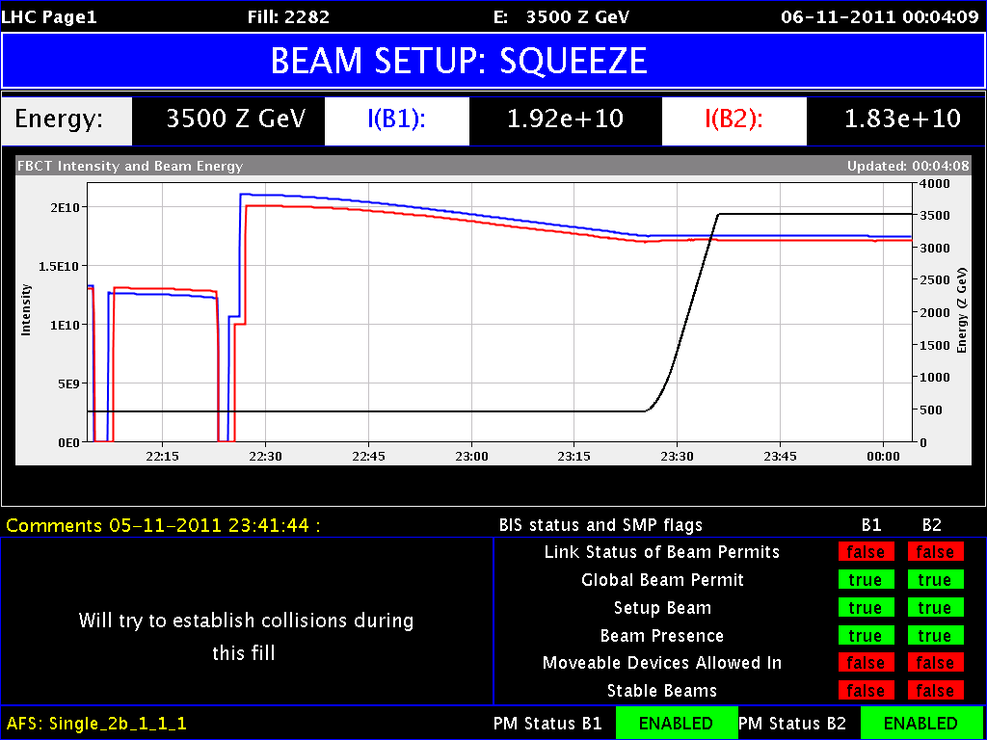
IBS, debunching at injection
IBS will be a major battlefront for this run.

Slide 4
Other conditions
Wire scans for Beam 1 problematic
No BSRT for Pb at injection energy, as usual
BGI operational after Technical Stop
ADT (transverse damper) off
Some injection oscillations, emittance dilution
Setup for Pb next weekend
VRF = 6 MV, may be increased later
Low blow-up of longiutinal emittance in ramp for now
Oxygen deficiency alarm at 23:24
Firemen came
Turned out to be communication problem

Slide 5
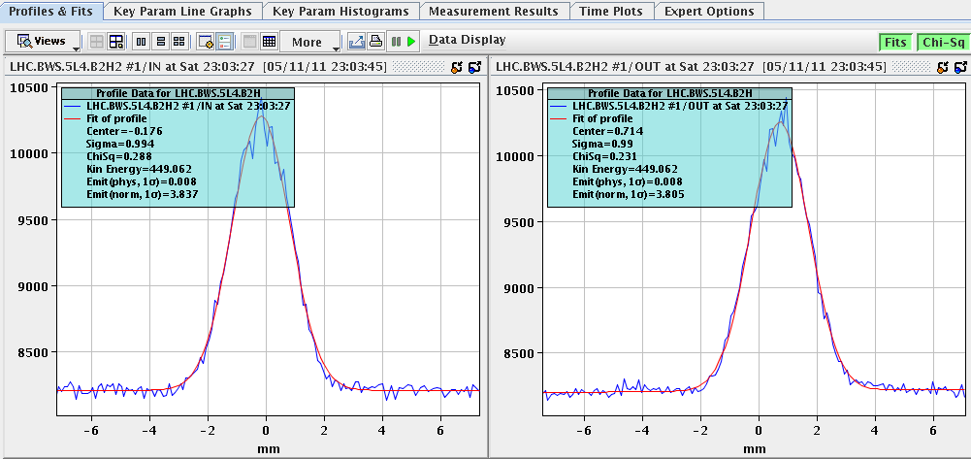
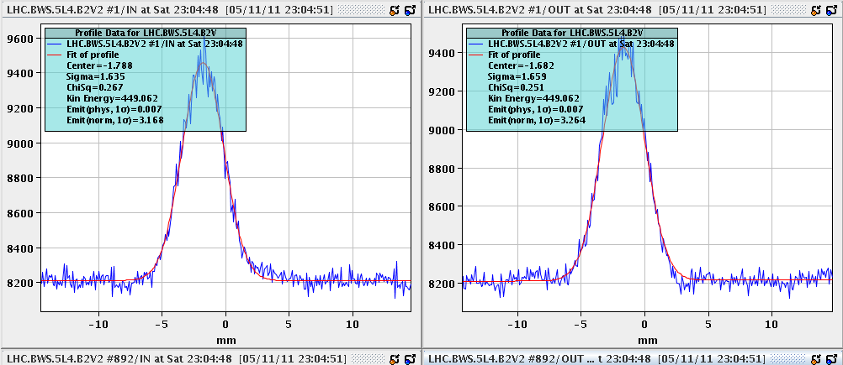
Emittance after 1 h at injection

Slide 6
Ramp and squeeze
00:20 6/11/2011 First ramp and squeeze finished
< 3 h after first injection
Established with protons previous weekend
Beam 2 ramp and squeeze already in p-Pb MD
β*=(1,1,1,3) m, briefly held record as the most squeezed LHC optics so far …
Nuclear synchrotron radiation again

Slide 7
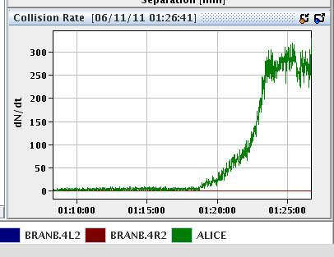
Collisions
Collisions found using neutrons in either side ALICE ZDC
Trims of several 100 µm
Still using LUCID (ATLAS), HF (CMS) – lower rates
TCTVs around ALICE fully opened
ZDC data OK so far (aperture worry …)
Collisions for experiments (ADJUST mode) for 1 hour, then dumped, refilled

Slide 8
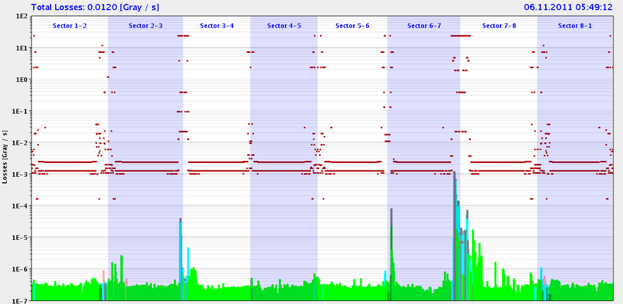
Loss maps at injection, Sunday early morning
Injection-rephasing problem solved
Almost complete set of loss maps at injection energy
Problem of TCTs in IR1 morning and early afternoon, also an RF cavity, …
Beam 1 horizontal

Slide 9
From 15:00 Sunday
Ramp, squeeze, collimator setup, betatron loss maps, asynchronous dump test (low intensity)
could not move in the ALFA pots for the loss maps in collisions
Poor lifetimes sometimes, collimators
Asynchronous dump test (low intensity)
From Brennan: "There was very little beam, with losses of only about 1 Gy/s on the TCDQs for both beams - however, there is nothing above 1e-3 on any TCTs, so for me this is still OK to continue, as there was some beam in the gap and the relative losses on TCTs are below about 5e-4."
Concern: “skipped the checks on LHCb magnet in the state machine checks as LHCb will stay OFF during ion run” in logbook, not quite true

Slide 10
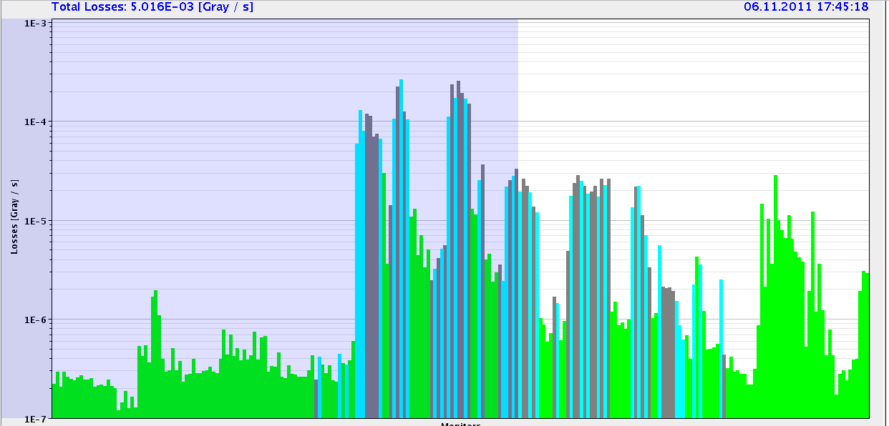
Pb ion collimation loss pattern
Expected high leakage to dispersion suppressor
All loss maps done, to be analysed.

Slide 11
Status summary for HI2011
Injection, ramp, squeeze, collimator setup etc OK
Remaining items before Stable Beams
Transverse damper setup (6 h)
Collimator ramp functions
BGI improvements
TI8 steering to be improved
Some minor items
+ Recovery from Technical Stop …

